Slide 1
Bubble issue with MUX and OB1 control
Issues with bubbles being introduced into system. Typically happens after long delay periods.
One hypothesis is MUX valve homing which seems to be a built in action that I cannot control, but happens if valve isn’t moved every x minutes. Possible that it still does it after Y time too, but its unknown.
Ob1 sometimes disobeys commands and need to cut power to have control over a hard stop point

Slide 2
MUX home test
Bubbles
Swap to valve 11 and back to 12
Turn off
OB1
Home Mux
Valve
Turn on
OB1

Slide 3
Turn off
OB1
Turn on
OB1
Home MUX, switch valves and back to 12 in one action

Slide 4
Ideas
It seems that homing the valve throws it off sometimes and doesn’t allow perfect alignment when going to a valve. A solution to this seems to be to select a different valve than the desired valve and then swing it back to the desired valve. This is easily implemented in the main auto code.
Tested and repeated many times and if home is done and no move from valve and back to valve, I get a massive amount of air introduced.

Slide 5
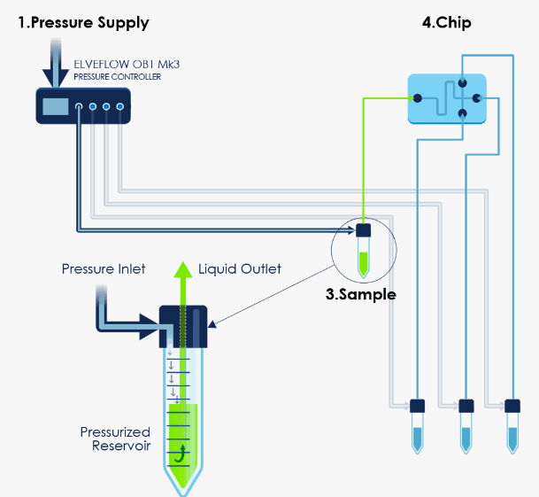
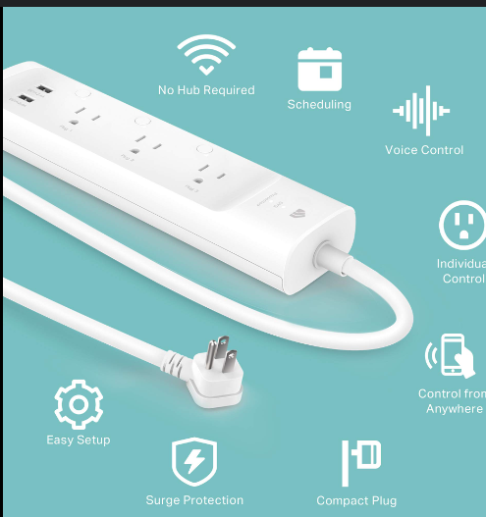
Digital Back Flips for Fluidic System
Unreliability in fluidic system stemming from system freezes and not accepting commands
Python
Resend command
Tell power strip to power cycle OB1
Didn’t respond to command
Frozen Flow meter
Plugged into smart power strip

